Slide 1
Unit 2 Modeling the Information of an Enterprise Using Enhanced Entity/Relationship Diagrams
Notes:
28

Slide 2
ER Diagrams in Context

Slide 3
Introduction

Slide 4
Purpose of ER Model and Basic Concepts
Entity/relationship (ER) model provides a common, informal, and convenient method for communication between application end users (customers) and the database designers in order to model the information’s structure
This is conceptual design, though some call this logical design
This is a preliminary stage towards defining the database using a formal model, such as the relational model, to be described later
The ER model, typically employs ER diagrams, which are pictorial descriptions to visualize information’s structure
ER models are well-suited for database designs and are both simple and powerful
But whatever needs to specified about the application that cannot be specified using ER diagrams, needs to be stated as textual comments

Slide 5
Purpose of ER Model and Basic Concepts
There are three basic concepts appearing in the original ER model, which has since been enhanced[
We will present the model from simpler to more complex concepts, with examples on the way
We will go beyond the original ER model, and cover a version of the Enhanced ER (EER) model, while still referring to as an ER model, as is customary
While the ER model’s concepts are standard, there are several varieties of pictorial representations of ER diagrams
We will focus on one of them: Chen’s notation
We will also cover Crow’s foot notation, which is particularly suited for relational database design
Others are simple variations, so if we understand the above, we can easily understand all of them
You can look at some examples at: http://en.wikipedia.org/wiki/Entity-relationship_model

Slide 6
Basic Concepts
The three basic concepts are (elaborated on very soon):
Entity. This is an “object/thing.” Cannot be defined even close to a formal way but must be identifiable. Examples of identification:
Zvi Kedem (assuming that’s unique)
The eldest child of Priyanka Laskshminarayan (assuming that Priyanka Laskshminarayan is unique)
Person with NYU Net Id zk1
Los Angeles, CA, USA
The country whose capital is Paris
Relationship. Entities participate in relationships with each other. Examples:
Alice and Boston are in relationship Likes (Alice Likes Boston)
Bob and Atlanta are not in this relationship
Attribute (property). Examples:
Age is an attribute of persons
Size is an attribute of cities
Notes:
30

Slide 7
Entity

Slide 8
Entity and Entity Set
Entity is a “thing” that is distinguished from others in our application
Example: Alice
All entities of the same “type” form an entity set; we use the term “type” informally
Example: Person (actually, a set of persons). Alice is an entity in this entity set
What types (entity sets) are appropriate for an application may be a little tricky sometimes
We will see examples soon

Slide 9
Entity and Entity Set
Pictorially, an entity set is denoted by a rectangle with its type written inside
It contains the relevant entities
Example: Person contains all the “relevant” individual persons
By convention, singular noun, though we may not adhere to this convention if not adhering to it makes things clearer
By convention capitalized or all capitals if acronym
We will frequently use the term “entity” while referring to entity sets, unless that causes confusion

Slide 10
Entity and Entity Set
Example. When we say, “the set of all Boeing airplanes,” is this
The set of all the models in Boeing’s catalog (abstract objects), or
The set of airplanes that Boeing manufactured (concrete objects)?
We may be interested in both and have two entity sets with appropriate “relations” between them

Slide 11
Entity and Entity Set
Example: Do we partition people by sex or not?
We will assume in the course that each Person is of exactly one of two sexes
Woman
Man
We do this to have simple but rich enough examples
Do we have entity set Person or two entity sets: Woman and Man?
If our client is the U.S. Department of State and wants us to design a database of people renewing their passports with the input form https://eforms.state.gov/Forms/ds82.pdf; it requires sex to be one of the two
F
M
But the applicants are (likely) not partitioned by sex

Slide 12
Entity and Entity Set
Is it desirable to partition by sex?
Sometimes maybe not desirable: different handling of applicants to the NYU NY MS CS program
Sometimes maybe desirable: screen only women for cervical cancer
This allows better enforcement of constraints. You could “automatically” make sure that only entities in the entity set of Women could be scheduled for such a test
Sometimes maybe desirable: screen only men for prostate cancer
This allows better enforcement of constraints. You could “automatically” make sure that only entities in the entity set of Men could be scheduled for such a test
But maybe Sex should be a property of the entities in Person, so we can just have the entity set Person?
We introduce properties, formally attributes, soon
But maybe it will be good to have three entity sets: Person, Woman, with appropriate “relations” between them?

Slide 13
Attribute

Slide 14
Attribute
An entity has a set of zero or more attributes, which are some properties
Each attribute is drawn from some domain (such as integers) possibly augmented by NULL (more about NULLs later; for now, think as indicating “unknown”)
All the entities in an entity set have the same set of attributes, though generally not with the same values
Attributes of an entity are written in ellipses (for now solid lines) connected to the entity
Example: FN: “First Name.” LN: “Last Name.” DOB: “Date of Birth.”

Slide 15
Attribute
Attributes can be
Base (such as DOB) or derived (from other sources) denoted by dashed ellipses (such as Age, derived from DOB and the current date)
Simple (such as DOB) or composite (made of components) having their component attributes attached to them (such as Address, when we think of it explicitly as consisting of street and number and restricting ourselves to one city only)
Singlevalued (such as DOB) or multivalued (with unspecified in advance number of values) denoted by thick-lined ellipses (such as Child; a person may have any number of children; we do not consider children as persons in this example, this means that they are not elements of the entity set Person, just attributes of the entities in that set)

Slide 16
Thick Lines or Double Lines
Some people (not we) use the convention of using double lines whenever we use thick lines
This is now obsolete and was used when the diagrams were drawn by hand
But many systems, e.g., draw.io (https://app.diagrams.net/), still use it
We will use thick lines
Using our example, the ER diagram using double lines would look like below

Slide 17
Attribute
To have a simple example of a person with attributes
Child: Bob
Child: Carol
FN: Alice; we use FN for first name or given name
LN: Xie; we use LN for last name or family name
DOB: 1980-01-01
Address.Number: 100
Address.Street: Mercer
Age: Current Date minus DOB specified in years (rounded down)

Slide 18
Attributes
By obvious extensions, we can have more complex structures, such as in the example below We will discuss the meaning of underlines next

Slide 19
Key

Slide 20
How to Identify/Specify an Entity?
We have an entity set and we want to identify/specify an individual entity in it
We have 3 ways of doing it
Using its attributes
Using its relationship to an entity in a different entity set
Using its attributes and a relationship to an entity in a different entity set
We start with “using its attributes” and talk about keys next
We will talk about the other options when we study weak entities

Slide 21
Sets, Subsets, and Supersets
Relations subset and superset are defined among sets
This is analogous to
Let us review by an example of three sets
A = {2,5,6}
B = {1,2,5,6,8}
C = {2,5,6}
Then we have
A B and A is a subset of B
and A is a proper subset, as it is not all of B; A B
A C and A is a subset of C
and A is not a proper subset of C, as it is equal to C; A = C
Caution: sometimes is used to denote what we denote by

Slide 22
Keys
Most of the times (not always), some subset S (proper or not) of the attributes of an entity has the property
The values of attributes in S are always known (for every entity)
Any two possible entities that are equal on the attributes in S are equal (are really one entity); can also say that once the values of key attributes are fixed, all other values are fixed also
Minimality: No proper subset of S has this property
Such an S is called a key (and sometimes: candidate key)
Therefore, two different entities in an entity set must differ on at least one attribute in a key
Example: S consisting of Longitude and Latitude

Slide 23
Keys
Examples of non-keys
Longitude (not enough)
Longitude and Name (not enough)
Longitude, Latitude, and Name (enough, but too much)

Slide 24
The Need For Minimality
A key must be minimal, no proper subset could serve as a key
Obvious semantics:
Net ID specifies a Student: Net ID could be a key
N Number specifies a Student: N Number could be a key
Net ID and N Number together will not work as a key
A mistake I have seen before, even from people who worked several years on DBMSs
Counter-example: Assume that (Net Id, N Number) are declared as a key
Then the two entities below have different keys, but cannot be both in the database as the N Numbers are the same but Net Ids are not
abc123, N12345678, Xie efg456, N12345678, Xie

Slide 25
Primary Keys
If an entity set has one or more keys, one of them (no formal rule which one) is chosen as the primary key
In the ER diagram, the attributes of the primary key are underlined
Let’s assume that every country is partitioned into states and for every
Longitude and Latitude are always known
No two cities can have the same values of (Longitude, Latitude)
Country, State, and Name are always known
No two cities can have the same values of (Country, State, Name)

Slide 26
Primary Keys
Under our assumptions, two primary key are possible, and we must choose one of them
So, in our example two ER diagrams are possible

Slide 27
UNIQUE Constraint
Let’s assume for now that some countries are partitioned into states, and some are not
For countries with states
No two cities in the same state can have the same name
For countries without states
No two cities (in that country) can have the same name
So sometimes the value of State is unknown/inapplicable
(Country, State, City) cannot be the primary key
But no two cities can have the same values of (Country, State, Name
This is specified by stating that (Country, State, City) is UNIQUE
What exactly this means will be discussed when we talk about SQL DDL
Of course, every key satisfies the UNIQUE constraint

Slide 28
Relationship

Slide 29
Relationship
Several entity sets (one or more) can participate in a relationship
Relationships are denoted by diamonds, to which the participating entities are “attached” at the vertices of the diamond
A relationship could be unary, binary, ternary, ….
These refer to the number of “slots” in a relationship
< is binary as there are two “slots” for variables, e.g., x < y (the “slots” are x and y)
< 0 is unary as there is one “slot” for variables, e.g., x < 0 (the “slot” is x)
By convention, a capitalized verb in third person singular (e.g., Likes), though we may not adhere to this convention if not adhering to it makes things clearer

Slide 30
Relationship
We will have some examples of relationships
We will use three entity sets, with entities (and their attributes) in those entity sets listed below
Person | Name
 | Chee
 | Lakshmi
 | Marsha
 | Michael
 | Jinyang
Vendor | Company
 | IBM
 | Apple
 | Dell
 | HP
Product | Type
 | computer
 | monitor
 | printer

Slide 31
Binary Relationship
Let’s look at Likes, listing all pairs of (x,y) where person x Likes product y, and the associated ER diagram
First listing the relationship informally:
Chee likes computer
Chee likes monitor
Lakshmi likes computer
Marsha likes computer
Note
Not every person has to Like a product
Not every product has to have a person who Likes it (informally, be Liked)
A person may Like many products
A product may have many persons each of whom Likes it
“Likes” is just a word in the diagram: maybe product likes person

Slide 32
Relationships
Formally we say that R is a relationship among (not necessarily distinct) entity sets E₁, E₂, …, E_{n} if and only if R is a subset of E₁ × E₂ ×…× E_{n} (Cartesian product)
In our example above:
n = 2
E₁ = {Chee, Lakshmi, Marsha, Michael, Jinyang}
E₂ = {computer, monitor, printer}
E₁ × E₂ = { (Chee,computer), (Chee,monitor), (Chee,printer), (Lakshmi,computer), (Lakshmi,monitor), (Lakshmi,printer), (Marsha,computer), (Marsha,monitor), (Marsha,printer), (Michael,computer), (Michael,monitor), (Michael,printer), (Jinyang,computer), (Jinyang,monitor), (Jinyang,printer) }
R = { (Chee,computer), (Chee,monitor), (Lakshmi,computer), (Marsha,monitor) }
R is a set (unordered, as every set) of ordered tuples, or sequences (here of length two, that is pairs)

Slide 33
Our Cartesian Product

Slide 34
Our Instance Of The Relationship

Slide 35
Relationships
Let us elaborate
E₁ × E₂ was the “universe”
It listed all possible pairs of a person liking a product
At every instance of time, in general only some of this pairs corresponded to the “actual state of the universe”; R was the set of such pairs

Slide 36
Important Digression
Ultimately, we will store (most) relationships as tables
So, our example for Likes could be
And we identify the “participating” entities using their primary keys
Likes | Name | Type
 | Chee | Computer
 | Chee | Monitor
 | Lakshmi | Computer
 | Marsha | Computer

Slide 37
Ternary Relationship
Let’s look at Buys listing all tuples of (x,y,z) where person x buys product y from vendor z
Let us just state it informally:
Chee buys computer from IBM
Chee buys computer from Dell
Lakshmi buys computer from Dell
Lakshmi buys monitor from Apple
Chee buys monitor from IBM
Marsha buys computer from IBM
Marsha buys monitor from Dell

Slide 38
Relationship With Nondistinct Entity Sets
Let’s look at the binary relationship Likes, listing all pairs of (x,y) where person x Likes person y
Relationships in which a set participates more than once are sometimes called recursive; this term is not important
Let us just state it informally
Chee likes Lakshmi
Chee likes Marsha
Lakshmi likes Marsha
Lakshmi likes Michael
Lakshmi likes Lakshmi
Marsha likes Lakshmi
Note that pairs must be ordered to properly specify the relationship, Chee likes Lakshmi, but Lakshmi does not like Chee

Slide 39
Relationship With Nondistinct Entity Sets
Again:
Chee likes Lakshmi
Chee likes Marsha
Lakshmi likes Marsha
Lakshmi likes Michael
Lakshmi likes Lakshmi
Marsha likes Lakshmi
Formally Likes is a subset of the Cartesian product Person × Person, which is the set of all ordered pairs of the form (person,person)
Likes is the set { (Chee,Lakshmi), (Chee,Marsha), (Lakshmi,Marsha), (Lakshmi,Michael), (Lakshmi,Lakshmi), (Marsha,Lakshmi) }
Likes can be though of as a directed graph in which persons serve as vertices and arcs specify who likes whom

Slide 40
Important Digression
Ultimately, we will store (most) relationships as tables
So, our example for Likes could be
We identify the “participating” entities using their primary keys
But it is difficult to see (unless we keep track of columns order) whether Lakshmi Likes Michael or Michael Likes Lakshmi
Likes | Name | Name
 | Chee | Lakshmi
 | Chee | Marsha
 | Lakshmi | Marsha
 | Lakshmi | Michael
 | Lakshmi | Lakshmi
 | Marsha | Lakshmi

Slide 41
Relationship With Nondistinct Entity Sets
Frequently it is useful to give roles to the participating entities, when, as here, they are drawn from the same entity set.
So, we may say that if Chee likes Lakshmi, then Chee is the “Liker” and Lakshmi is the “Liked”
Roles are explicitly listed in the diagram, but the semantics of what they mean cannot be deduced from looking at the diagram only

Slide 42
Important Digression
Ultimately, we will store (most) relationships as tables
So, our example for Likes could be
We identify the “participating” entities using their primary keys, but we rename them using roles
So, we do not need to keep track of columns order and we know that Lakshmi Likes Michael and Michael does not Like(s) Lakshmi, though we still do not know what “Likes” really means
Likes | Liker | Liked
 | Chee | Lakshmi
 | Chee | Marsha
 | Lakshmi | Marsha
 | Lakshmi | Michael
 | Lakshmi | Lakshmi
 | Marsha | Lakshmi

Slide 43
Relationship With Nondistinct Entity Sets
Consider Buys, listing all triples of the form (x,y,z) where vendor x buys product y from vendor z
A typical tuple might be (Dell,printer,HP), meaning that Dell buys a printer from HP

Slide 44
ER Diagrams

Slide 45
ER Diagrams
To show which entities participate in which relationships, and which attributes participate in which entities, we draw line segments between:
Entities and relationships they participate in
Attributes and entities they belong to
We also underline the attributes of the primary key for each entity that has a primary key
Below is a simple ER diagram (with a simpler Person than we had before):

Slide 46
Further Refinements to the ER Model
We will present, in steps, further refinements to the model and associated diagrams
The previous modeling concepts and the ones that follow are needed for producing a data base design that models a given application well
We will then put that together in a larger comprehensive example

Slide 47
Relationship With Attributes
Consider relationship Buys among Person, Vendor, and Product
We want to specify that a person Buys a product from a vendor at a specific price
Price
is not a property of a vendor, because different products may be sold by the same vendor at different prices
is not a property of a product, because different vendors may sell the same product at different prices
is not a property of a person, because different products may be bought by the same person at different prices

Slide 48
Relationship With Attributes
So, Price is really an attribute of the relationship Buys
For each tuple (person, product, vendor) there is a value of price More formally, there is at most one value of price

Slide 49
Entity Versus Attribute
Entities can model situations that attributes cannot model naturally
Entities can
Participate in relationships
Have attributes
Attributes cannot do any of these (though you could think that in a composite attribute an attribute may have attributes)
Let us look at a “fleshed-out example” for possible alternative modeling of Buys

Slide 50
Other Choices for Modeling Buys
Price is just the actual amount, the number in $’s
So there likely is no reason to make it an entity as we have below
We should probably have (as we had earlier less fleshed out)

Slide 51
Other Choices for Modeling Buys
Or should we just have this?
Not if we want to model something about a person, such as whom a person likes
This requires a person to be able to enter into a relationship (with other persons)
And we cannot model this situation if person is an attribute of Buy
Similarly, for product and vendor

Slide 52
Functionality (As in Mathematical Functions)

Slide 53
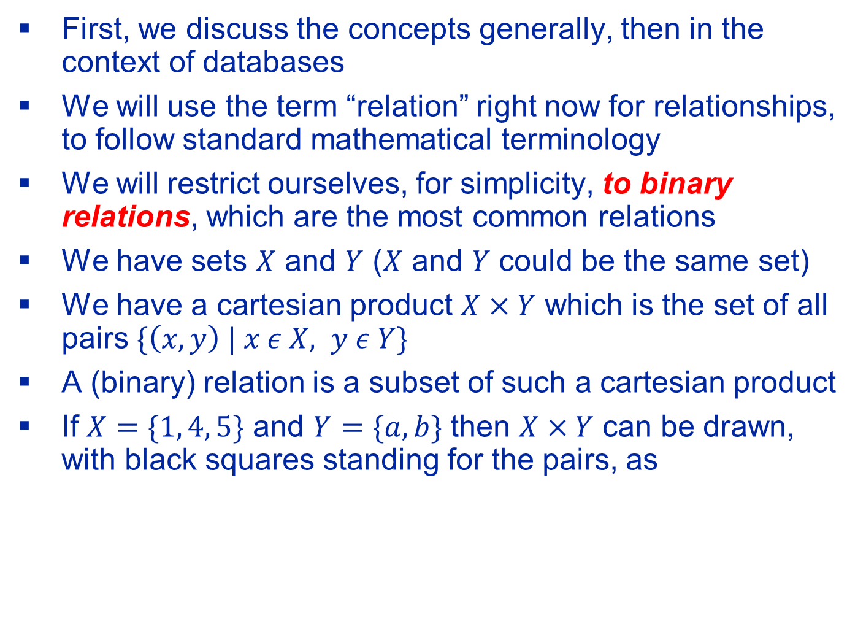
Relationships/Relations And Functions (Some Review Of Previous Material)
First, we discuss the concepts generally, then in the context of databases
We will use the term “relation” right now for relationships, to follow standard mathematical terminology
We will restrict ourselves, for simplicity, to binary relations, which are the most common relations
We have sets $X$ and $Y$ ($X$ and $Y$ could be the same set)
We have a cartesian product $X×Y$ which is the set of all pairs $\{\left(x,y\right) | x ε X, y ε Y\}$
A (binary) relation is a subset of such a cartesian product
If $X=\{1, 4, 5\}$ and $Y=\{a, b\}$ then $X×Y$ can be drawn, with black squares standing for the pairs, as

Slide 54
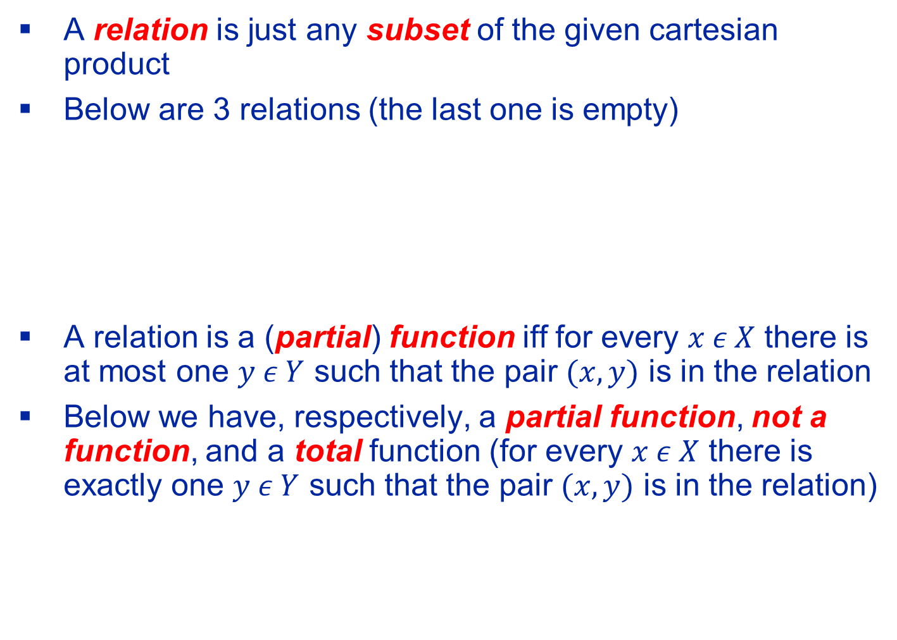
Relationships/Relations And Functions
A relation is just any subset of the given cartesian product
Below are 3 relations (the last one is empty)
A relation is a (partial) function iff for every $x ε X$ there is at most one $y ε Y$ such that the pair $(x, y)$ is in the relation
Below we have, respectively, a partial function, not a function, and a total function (for every $x ε X$ there is exactly one $y ε Y$ such that the pair $(x, y)$ is in the relation)

Slide 55
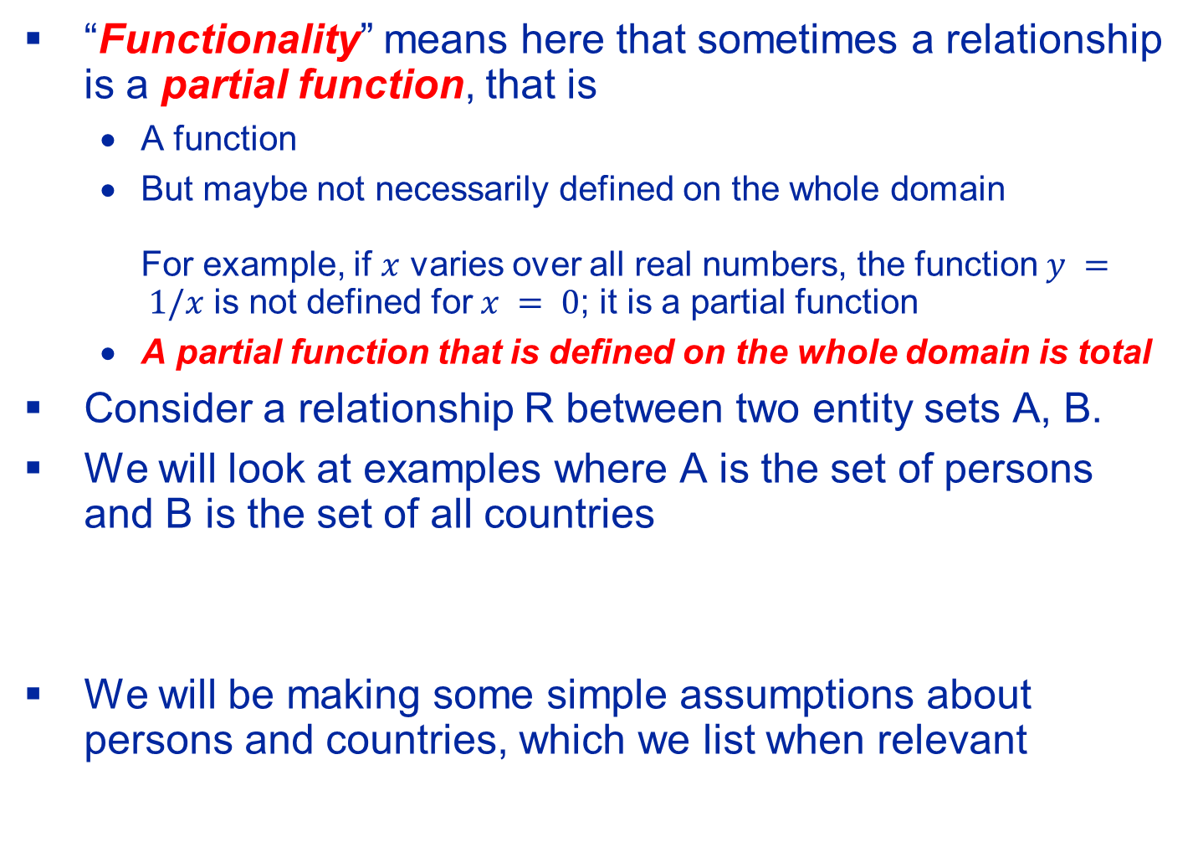
Binary Relationships and Their Functionality
“Functionality” means here that sometimes a relationship is a partial function, that is
A function
But maybe not necessarily defined on the whole domain For example, if $x$ varies over all real numbers, the function$y = 1/x$ is not defined for $x = 0$; it is a partial function
A partial function that is defined on the whole domain is total
Consider a relationship R between two entity sets A, B.
We will look at examples where A is the set of persons and B is the set of all countries
We will be making some simple assumptions about persons and countries, which we list when relevant
Notes:
35

Slide 56
Binary Relationships As Directed Graphs
Binary relationships are by far the most important relationships
In fact, jumping ahead, all relationships in relational databases are binary (and many-to-one, which we will understand in the next unit)
Formally, all relationships in a relations databases are partial functions
Binary relationships can be naturally represented by directed graphs
There will be 2 important cases to consider for a binary relationship between R and S
R and S are distinct sets
R and S are the same set

Slide 57
R and S Are Distinct Sets
For the example, let R be Persons and S be Cities
The graph is bipartite: all the arcs (directed edges) are from the vertices in R to vertices in S
The relationship is Likes

Slide 58
R and S Are The Same Set
For the example, let’s have R to be Persons
For example, the relationship is Likes

Slide 59
Binary Relationships and Their Functionality
Relationship R is many to one from A to B if and only if for each element of A there exists at most one element of B related to it
Example: R is Born (in)
Each person was born in at most one country (maybe not in a country but on a ship in the middle of an ocean or maybe we do not know the country for the person), so there is a partial function from set Person to set Country
Maybe nobody was born in some country as it has just been established
The picture on the right is a bipartite graph describing the universe of 4 persons and 3 countries, with lines indicating which person was born in which country
We will have similar diagrams for other examples
Notes:
35

Slide 60
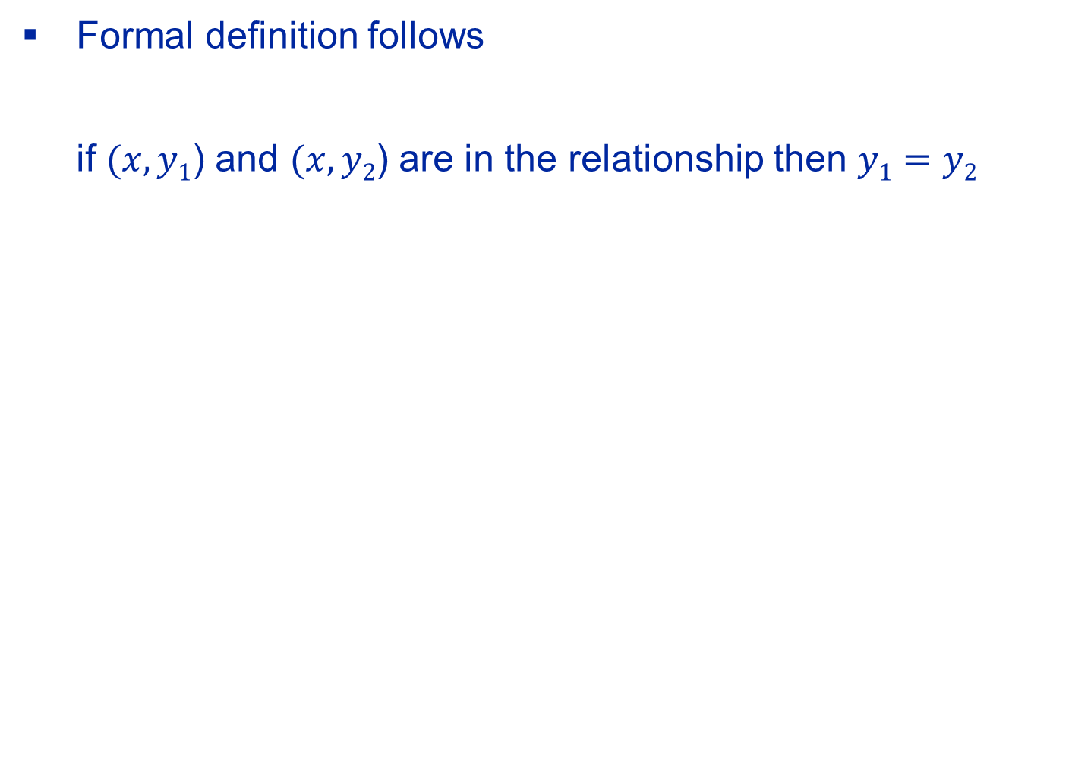
Many-To-One Relationships
Formal definition follows if $(x, y1$) and $(x, y2$) are in the relationship then $y1=y2$

Slide 61
Binary Relationships and Their Functionality
Relationship R is called one to one between A and B if and only if for each element of A there exists at most one element of B to which it is related and for each element of B there exists at most one element of A which is related to it
Example: R is Heads
Each Person is a Head (President, Queen, etc.) of at most one country (not true in reality)
Each country has at most one head (maybe the queen died, and no monarch for that country exists now)
Notes:
35

Slide 62
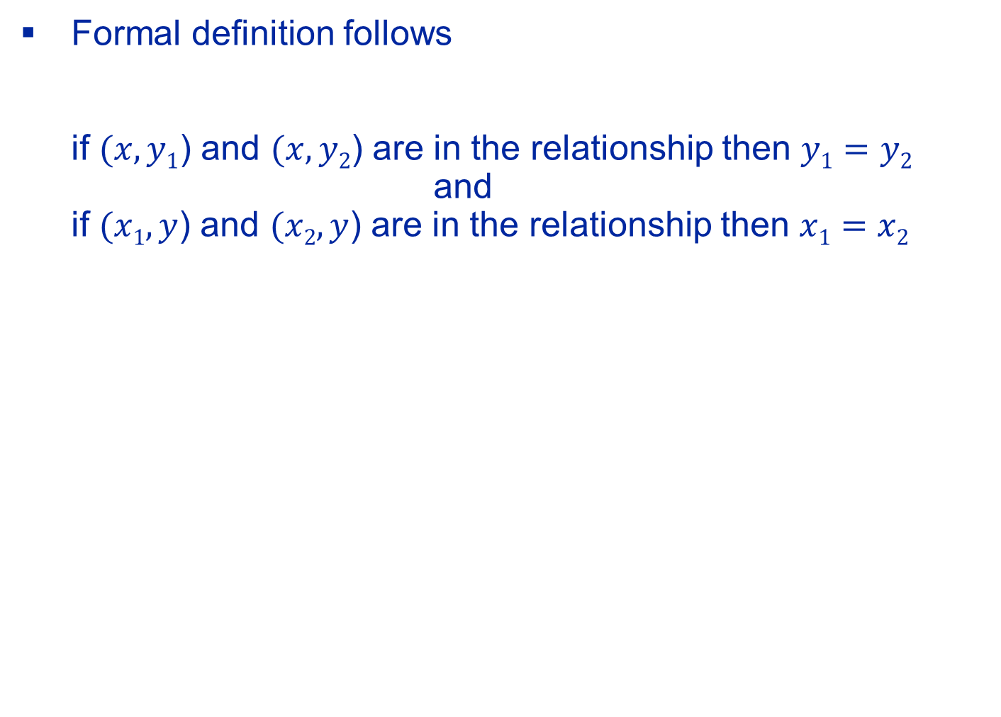
One-To-One Relationships
Formal definition follows if $(x, y1$) and $(x, y2$) are in the relationship then $y1=y2$ and if $(x1, y$) and $(x2, y$) are in the relationship then $x1=x2$

Slide 63
Many-To-Many Relationships
There are no restriction beyond its being a relationship

Slide 64
Binary Relationships and Their Functionality
A relationship is called many to many between A and B, if there are no restrictions.
Example: R is “Likes”
Notes:
35

Slide 65
Binary Relationships and Their Functionality
We have in effect considered the concepts of partial functions of one variable.
The first two examples were partial functions (to remind, “partial” means that the function does not have to be defined on all the elements of its domain)
The last example was not a function
Pictorially, functionality for binary relationships can be shown by drawing an arc head in the direction to the “one”
Notes:
35

Slide 66
Classroom Exercise
What is the difference between these two diagrams, if any, ignoring the names of the relationships?

Slide 67
Binary Relationships and Their Functionality
How about the properties of a relationship? Let’s look at an example
Date: when a person and a country are in a relationship this attribute is the first day when they entered into the relationship (Date marked with a black square)
Notes:
38

Slide 68
Binary Relationships and Their Functionality
Can make Date in some cases a property of an entity
In Born “slide” the Date to the Person, but not the Country
In Heads “slide” the Date to either the Person or the Country (but not for both, as this would be redundant)
Cannot “slide” the Date to either “Liker” or “Liked”
Can “slide” if no two squares end up in the same entity

Slide 69
Binary Relationships and Their Functionality
If the relationship is many-to-one, then a property of the relationship can be attributed to the “many” side
More generally, we could say that if the relationship is many-to-one then the property of the relationship can be attributed to the side “opposite” to the “one” side
The following can be done if the relationship is one-to-one
A property of the relationship can be “attributed” to any of the two sides
Each of these two sides is “opposite” to a “one” side

Slide 70
Alternate Designs
Entities “inheriting” attributes of relationships when the relationships are not many to many

Slide 71
Non-Binary Many-To-One Relationships
There could also be relationships that are not binary but still many-to-one
In the example below, a man and a woman could have met in at most one country
This is indicated by an arrow

Slide 72
Non-Binary Many-To-One Relationships
Below an example of modeling when for every triple of entities (a,b,c) from A, B, and C, there is at most one entity d in D

Slide 73
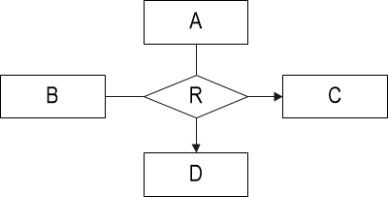
Non-Binary Many-To-One Relationships
However, cannot model using ER diagrams more complex cases such as the case where for every pair of entities (a,b) in A and B there is at most one entity in C and at most one entity in D.
Also, that’s less important as we will see later
It is important to know about the two partial functions above, but the diagram below is not permitted in standard ER diagrams (though it could have been)
It would be confusing as without annotations it is not clear from it that, for example it is not the case that
For every (a,c) whatever b is there is at most one d
For every (b,d) whatever a is there is at most one c

Slide 74
Non-Binary Many-To-One Relationships
Assume now that for every pair of entities (a,b) from A and B, there is at most one entity d in D.
Then we can draw because, of course, it is also the case that for every triple of entities (a,b,c) from A, B, and C, there is at most one entity d in D
But we must add a text annotation stating that the relationship is just from A and B

Slide 75
Arrows From Relationships To Entities
Following on the previous discussions we allow at most one arrow “coming out” of any relationship
Following on the example of the Heads relationship earlier There is one exception: A binary one-to-one relationship has 2 arrows coming out of it
We will discuss this case in greater detail in the unit dealing with relational implementation

Slide 76
Aggregation

Slide 77
Aggregation: Relationships as Entities
It is sometimes natural to consider relationships as if they were entities.
This will allow us to let relationships to be treated as entities, e.g., participate in other “higher order” relationships
Here each instance of Buys needs to be approved by (at most) one agency
Relationship is “made into” an entity by putting it into a rectangle; note that the edge between Buys and Approves touches the Buys rectangle but not the Buys diamond, to make sure that we won’t get confused
Notes:
45

Slide 78
Aggregation: Relationships as Entities
Relationship is “made into” an entity by putting it into a rectangle; note that the edge between Buys and Approves touches the Buys rectangle but not the Buys diamond, to make sure that we won’t get confused
Note: Sometimes the symbol of diamond in a rectangle is used to denote a so-called, associative entity
Notes:
45

Slide 79
Weak Entities

Slide 80
Strong and Weak Entities
We have two entity sets
Man
Woman
Woman has a single attribute, SSN
Let us defer the discussion of the attributes of Man
A woman has 5 sons, among them Aarav and Wei, neither of the two is her eldest son and she writes the following in her will:
My SSN is 123-45-6789 and I leave $100 to my eldest son and $200 to my son Aarav and $300 to my son Wei …
How do we identify these 3 men from among all the men in the universe? Let’s defer the answer for now

Slide 81
Strong and Weak Entities
A strong entity (entity set): Its elements can be identified by the values of their attributes, that is, a (primary) key can be made of its attributes
Without saying that, we assumed only such entities so far
A weak entity (entity set): Its elements cannot be identified by the values of their attributes: that is, no primary key can be made from its own attributes
Such entities can be identified by a combination of their attributes and the relationship they have with an entity in another entity set
Notes:
49

Slide 82
Man as a Strong Entity
Most entities are strong: a specific entity can be distinguished from other entities based on the values of its attributes
We assume that every person has his/her own SSN
Woman is a strong entity as we can identify a specific woman based on her attributes. She has a primary key: her own SSN
Man is a strong entity as we can identify a specific man based on his attributes. He has a primary key: his own SSN

Slide 83
Man as a Weak Entity
We assume that women are given SSNs
Men are not given SSNs; they have first names only, but for each we know who the mother is (that is, we know the SSN of the man’s mother)
Man is a weak entity as we cannot identify a specific man based on his own attributes
Many women could have a son named Bob, so there are many men named Bob
However, if a woman never gives a specific personal name to more than one of her sons, a man can be identified by his name and by his mother’s SSN
Note double underline and thick lines indicating the above

Slide 84
Man as a Weak Entity
We could have the following situation of 2 mothers: one with 2 sons, and one with 3 sons, when we gave people also heights in inches (just to have additional attributes that are not necessary for identification)
SSN: 070-43-1234, height: 65
Name: Bob, height 35
Name: Dao-I, height 35
SSN: 056-35-4321, height 68
Name: Bob, height 35
Name: Mohammed, height 45
Name: Vijay, height 84

Slide 85
Man as a Weak Entity
Assume that a woman does not have more than one son with a specific first name
Name becomes a discriminator; a discriminator cannot be NULL
Man can be identified by the combination of:
The Woman to whom he is related under the Son relationship. This is indicated by thick lines around Son (it is weak). Thick line connecting Man to Son indicates the relationship is total on Man (every Man participates) and it used for identification
His Name. The Name is now a discriminator; this is indicated by double underline
We add an arrowhead for consistency, although we know that semantically the relationship must be many-to-one

Slide 86
Man as a Weak Entity
Discriminator is used to distinguish among Men related to the Woman
It is always known, similarly to the primary key of strong entities
This is the first meaning of discriminator
There is another meaning, which we will see when we study the ISA relationship
The term is, unfortunately, overloaded, as the two meaning are not related
Note that the term “discriminate” has no negative connotations per se
“[T]o recognize that there is a difference between people or things; to show a difference between people or things”. From https://www.oxfordlearnersdictionaries.com/us/definition/american_english/discriminate#:~:text=1%5Bintransitive%2C%20transitive%5D%20to,discriminate%20(between%20A%20and%20B)

Slide 87
Man as a Weak Entity
We need to specify for a weak entity through which relationship it is identified; this is done by using thick lines
Otherwise, we do not know whether Man is identified through Son or through Works

Slide 88
Man as a Weak Entity
We need to specify for a weak entity through which relationship it is identified; this is done by using thick lines
Otherwise, we do not know whether Man is identified through Son or through Works
Thick lines for the relationship are sufficient; not necessary to have thick lines in other parts of the diagram

Slide 89
Man as a Weak Entity
Sometimes a discriminator is not needed
We are only interested in men who happen to be first sons of women
Every Woman has at most one First Son
So, we do not need to have Name for Man (if we do not want to store it, but if we do store it, it is not a discriminator)
Note an arrowhead to the left: each Woman has at most one First Son
This has nothing to do with Man being a weak entity in our design; it is just a semantic fact about the world
This is a one-to-one mapping

Slide 90
Man as a Weak Entity
In general, more than one attribute may be needed as a discriminator
For example, let us say that man has both first name and middle name
A mother may give two sons the same first name or the same middle name
A mother will never give two sons the same first name and the same middle name
The pair (first name, middle name) together form a discriminator

Slide 91
From Weaker to Stronger
There can be several levels of “weakness”
Here we can say that a horse named Speedy located in Saratoga Springs belongs to Bob, whose mother is a woman with SSN 072-45-9867
A woman can have several sons, each of whom can have several horses

Slide 92
Weak Entity or Multivalued Attribute?
We had
If nothing in the description of the application leads us to believe that Man could have its own attributes or could participate in relationships (other than with his mother), it might be more natural to implement the fragment of the database using a multivalued attribute
That’s what you should do in all your relevant assignments

Slide 93
Hierarchy (Class/Subclass) ISA

Slide 94
The ISA Relationship
For certain purposes, we consider subsets/subclasses of an entity set
The subset relationship between the set and its subset is called ISA, meaning “is a”
Elements of the subset, of course, have all the attributes and relationships as the elements of the set: they are in the “original” entity set
In addition, they may participate in relationships and have attributes that make sense for them
But those relationships and attributes do not make sense for every entity in the “original” entity set
The set and the subsets are sometimes referred to as class and subclasses
ISA is indicated by a triangle; some write ISA in the triangle
The elements of the subset are weak entities, as we will note next
Notes:
51

Slide 95
The ISA Relationship
Example: A subset that has an attribute that the original set does not have
We look at all the persons associated with a university
Some of the persons happen to be professors and some of the persons happen to be students
Student is a subset of Person
Professor is a subset of Person

Slide 96
ISA Is A Set Of One-To-One Functions
In our example there is one-to-one function between Person and Student
Person and Student can be thought of informally as two instantiations/roles of the same entity
In our example there is one-to-one function between Person and Professor
Person and Professor can be thought of informally as two instantiations/roles of the same entity

Slide 97
It Is Possible to Represent Hierarchies Using “Standard” Relationships
But not a good idea as less clear: don’t do that
We put “dummy” names A and B to follow our convention that relationships have names

Slide 98
Discriminators
Professor is a kind of weak entity because it cannot be identified by its own attributes (here: Salary)
Student is a kind of weak entity because it cannot be identified by its own attributes (here: GPA)
They do not have discriminators, they are identified by the primary key of the strong entity (Person)
We do not need to put Student and Professor in a rectangle with thick lines as being “under” ISA automatically tells us that they are weak entities identified by the primary key of the strong entity
There may be an attribute of Person (called discriminator) that can be used to determine who is a Student and who is a Professor
For a fake example: Professor names start with a A–M and Student names start with N–Z (but note advisement in our department for a real example)
Note: different meaning for discriminator than in weak entities

Slide 99
The ISA Relationship
A person associated with the university (and therefore in our database) can be in general
Only a professor
Only a student
Both a professor and a student
Neither a professor nor a student
A specific ISA could be
Disjoint: no entity could be in more than one subclass
Overlapping: an entity could be in more than one subclass
Total (also called Complete): every entity must be in at least one subclass
Partial: an entity does not have to be in any subclass
If nothing stated, then no restriction
“Overlapping” is not a restriction
“Partial” is not a restriction

Slide 100
The ISA Relationship (Example)
Some Persons can be Professors
Some Persons can be Students
Some Persons can be neither Professors nor Students
No Person can be both a Professor and a Student
We do not put P in the triangle as that is not a restriction
If applicable, can put both D and T in the triangle

Slide 101
The ISA Relationship (Example)
If there are no constrains on the ISA relationship leave the triangle empty
To repeat, note that the following are not constraints
Partial (does not have to be total)
Overlapping (does not have to be disjoint)
Therefore, do not state them in your assignments

Slide 102
The ISA Relationship
Example: subsets participating in relationships modeling the assumed semantics more clearly (every person has at most one woman who is the biological mother) for people in the database

Slide 103
The ISA Relationship
ISA is really a superclass/subclass relationship
ISA could be generalization: a superset is made from “more basic” sets
ISA could be specialization: subsets are made from the “more basic” set
This information could be added in annotations, if desired
Sometimes the “orientation” of a triangle is used to distinguish between specialization and generalization
We will not do that

Slide 104
A Sketch of a More Complex ER Diagram With Hierarchical ISAs

Slide 105
Cardinality Constraints

Slide 106
Cardinality Constraints
We can generalize the arrow notation
Best explained by examples

Slide 107
Cardinality Constraints
Can specify the range i..j, meaning between i and j
An asterisk, *, stands for unbounded

Slide 108
Cardinality Constraints
Further generalizations are possible
The cardinality notation allows for a richer set of constraints
The arrow notation is a special case
However, the arrow notation is preferred and that’s what we will use unless stated otherwise
We will discuss that further in the unit dealing with relational implementations

Slide 109
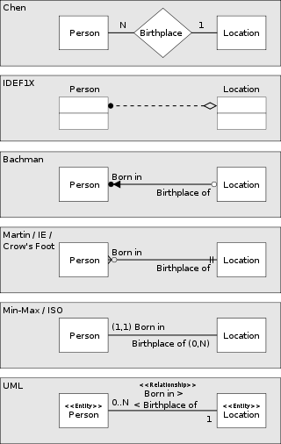
Many “Standards” Just For Binary Many-to-One
https://en.wikipedia.org/wiki/Entity%E2%80%93relationship_model

Slide 110
Software for Modeling

Slide 111
Drawing Software For ER Diagrams
Any software that can produce the shapes we need and connect them appropriately would be fine
We could have used the drawing shapes in PowerPoint
We will use draw.io at https://app.diagrams.net/
It is web-based so works for all operating systems; you may be able to install local copy if you like from https://www.diagrams.net/
It is easy to use and will let everybody use the same tool for the assignments
It has the shapes we need though a slight a variant from what I produced for the lectures
We will see how to use it later

Slide 112
Case Study

Slide 113
A Case Study
Next, we will go through a relatively large example to make sure we know how to use ER diagrams
We have a largish fragment of a large application to make sure we understand all the points
The fragment has been constructed so it exhibits interesting and important capabilities of modeling
It will also review the concepts we have studied earlier
It is chosen based on its suitability to practice modeling using the power of ER diagrams
It will also introduce some points, to be discussed later on how to design good relational databases
We will use the standard, arrow notation, which is understood by all

Slide 114
Our Application
We are supposed to design a database for a university
We will look at a small fragment of the application and will model it as an entity relationship diagram annotated with comments, as needed to express additional features
But it is still a reasonable “small” database
In fact, larger than what is typically discussed in database courses, but more realistic for modeling real applications
I have a seen a database used by a startup to manage what’s done by it and it is roughly only twice as big as our database, and it is not as sophisticated as ours

Slide 115
Our Application
Our understanding of the application will be described in a narrative form
While we do this, we construct the ER diagram
For ease of exposition (technical reasons only: limitations of the projection equipment) we look at the resulting ER diagram and construct it in pieces
We will pick some syntax for annotations, as there is no commonly accepted standard
One may try and write the annotations on the diagram itself using appropriate phrasing, but this will make our example too cluttered

Slide 116
Our Workflow
For each component we may have some or all of the following
Description in words, although we have it already in the client’s narrative
The ER diagram with the new component added
The additional annotations required to express all that is not expressible by the diagram and only that. If the slide is empty, there are no annotations
Comments for us, but not a part of the design
We will not list the domains of the attributes, as this is trivial to do and not interesting, but in a real application, this is needed and would be put in annotations
Unless stated or implied otherwise, the value of the attribute does not have to be known
Note, however, that the value of an attribute in a primary key or in a discriminator for weak entities is always known so do not say that

Slide 117
Building the ER Diagram
We describe the application in stages, ultimately getting the following diagram with additional annotations

Slide 118
Our ER Diagram So Far

Slide 119
Annotations

Slide 120
Comments
We must not say/write that Name in Horse is its primary key
We see that from the diagram

Slide 121
Our ER Diagram So Far

Slide 122
Annotations
The graph describing the Dam relationship is a forest of rooted trees

Slide 123
Comments
Dam (mother of a Horse) is a partial function
We are not told that it is total, so we have the default case of partial
Example of Dam

Slide 124
Our ER Diagram So Far

Slide 125
Annotations
LN, SS#, DOB in Person are always known
No two Persons can have the same SS#

Slide 126
Comments
It is very important to specify what we did for SS#
Semantically, SS# could have been chosen to be the primary key
The DBMS must enforce that

Slide 127
Our ER Diagram So Far

Slide 128
Annotations
Color in Car is always known

Slide 129
Our ER Diagram So Far

Slide 130
Annotations
Weight in Automobile is always known

Slide 131
Our ER Diagram So Far

Slide 132
Annotations

Slide 133
Our ER Diagram So Far

Slide 134
Annotations
Type is total

Slide 135
Comments
An entity in Car is an object (in which people can ride) and it is on a road (or parking lot, etc.)
An entity in Automobile is a catalog entry, say a page in a book describing all automobiles
Type tells us for each physical car what is the automobile catalog entry of which it is an instantiation
Each car is an instantiation of an exactly one catalog entry
So the entities in Car are not a subset of the entities in Automobile.
That's why we do not have ISA here
We will see ISA later
Not every Automobile is necessarily in the range of the relationship
There may be elements in Automobile for which no Car exists

Slide 136
Our ER Diagram So Far

Slide 137
Annotations
Every Person Has at least 2 Cars

Slide 138
Our ER Diagram So Far

Slide 139
Annotations

Slide 140
Comments
We do not have any letters (D or T) in the triangle and therefore there are no restrictions on the hierarchy
So, it could be partial, and it could be overlapping

Slide 141
Our ER Diagram So Far

Slide 142
Annotations
Salary is always known

Slide 143
Comments
Professor is a weak entity
This is generally true for related subclass/class
It is identified through a relationship with Person
You may think of a Professor as being an “alias” for some person:
“Split personality”
Note that there is a binary one-to-one mapping/function between Professor and Person and
It is total from Professor to Person
This is generally true for related subclass/class

Slide 144
Our ER Diagram So Far

Slide 145
Annotations

Slide 146
Our ER Diagram So Far

Slide 147
Annotations
Title in Course is always known

Slide 148
Comments
Course is a catalog entry appearing in the bulletin
Not a particular offering of a course
Example: CSCI-GA.2433 (which is a C#), not its current offering
In practice, we may need an attribute specifying the number of points, but let’s assume that it is always 3, so we do not have the attribute

Slide 149
Our ER Diagram So Far

Slide 150
Annotations
Prereq is a DAG (Directed Acyclic Graph)

Slide 151
Comments
We have a directed graph on courses, telling us prerequisites for each course, if any
To take an “upper” course every “lower” course related to it must have been taken previously
We needed the roles Lower and Upper for clarity
Note how we model well that prerequisites are not between offerings of a course but catalog entries of courses
Note however, that we have no tools to indicate in the ER diagram that Prereq must not have cycles

Slide 152
Comments
Example of Prereq: lower-level Courses before upper-level courses
As there is an arc (directed edge) from 101 to 103, 101 is a prerequisite for 103
Non-example of Prereq

Slide 153
Comments
Ultimately, we will store (most) relationships as tables
So, comparing to our earlier example for Likes, Prereq instance could be
We identify the “participating” entities using their primary keys, but rename the columns using roles
In each row, the course under Lower is prerequisite for the course under Upper
So, looking at the table we see that 101 is a prerequisite for 104 but 104 is not a prerequisite for 101
Prereq | Lower | Upper
 | 101 | 103
 | 101 | 104
 | 102 | 104
 | 104 | 105
 | 107 | 106
 | 107 | 108

Slide 154
Our ER Diagram So Far

Slide 155
Annotations

Slide 156
Our ER Diagram So Far

Slide 157
Annotations

Slide 158
Comments
A Professor may specify at most one Book for a Course

Slide 159
Our ER Diagram So Far

Slide 160
Annotations
Each Course has at least 1 Section related to it through Offered

Slide 161
Comments
Section is a weak entity set identified (partially) through a relationship Offered with Course
Partially, because it also has discriminant attributes
Section and Offered need to be handled together
One of our current sections (we have 3) can be identified at NYU by: CSCI-GA.2433, 2021, Fall, 001
This is a primary key, so it seems to be a strong entity
But it is ultimately a table in a relational database, so it is not completely relevant to the current unit
In the ER diagram, this Section is identified by
Being related to Course identified by CSCI-GA.2433 (primary key of the strong entity Course)
Having attribute values of 2021, Fall, 001 (discriminants for Section)

Slide 162
Our ER Diagram So Far

Slide 163
Annotations
Grade is a number between 0.0 and 4.0
A Section has between 3 and 50 Students

Slide 164
Comments
Students register for sections and not for courses

Slide 165
Our ER Diagram So Far

Slide 166
Annotations
GPA: Computed Attribute for Student by adding all the known numeric Grades, dividing by the number of Sections that the Student Took and got a numeric Grade

Slide 167
Comments
In our application, all the sections have the same number of points

Slide 168
Our ER Diagram So Far

Slide 169
Annotations

Slide 170
Comments
Professor teach Sections and not Courses

Slide 171
Our ER Diagram So Far

Slide 172
Annotations

Slide 173
Comments
We want to think of Taught as an entity because we want it to participate in a relationship

Slide 174
Our ER Diagram So Far

Slide 175
Annotations
Supervisor and Supervised cannot be the same Professor

Slide 176
Our Final ER Diagram

Slide 177
ER Diagram: Annotations
Collect all the annotations we have produced so far
Annotations are needed so that whoever converts an ER diagram + annotations into a relational schema + annotations can account for all the relevant constraints imposed on the application

Slide 178
Annotations For The ER Diagram
The graph describing the Dam relationship is a forest of rooted trees
LN, SS#, DOB in Person are always known
No two Persons can have the same SS#
Color in Car is always known
Weight in Automobile is always known
Type is total
Every Person Has at least 2 Cars
Salary is always known
Title in Course is always known
Prereq is a DAG (Directed Acyclic Graph)
Each Course has at least 1 Section related to it through Offered
Grade is a number between 0.0 and 4.0

Slide 179
Annotations For The ER Diagram
A Section has between 3 and 50 Students
GPA: Computed Attribute for Student by adding all the known numeric Grades, dividing by the number of Sections that the Student Took in which the Grades are known
Supervisor and Supervised cannot be the same Professor

Slide 180
Comments
Good design: few annotations

Slide 181
Hierarchy for Our ER Diagram
There is a natural hierarchy for our ER diagram
It shows us going from bottom to top how the ER diagram was constructed
Section and Offered have to constructed together as there is a circular dependency between them
Similar issue comes up when dealing with ISA

Slide 182
Hierarchy for Our ER Diagram

Slide 183
A Few Issues Of Importance

Slide 184
Some Additional Issues
We will go over a few issues that could not be conveniently covered previously without distracting from an orderly development

Slide 185
Some Constraints Are Difficult to Specify
Imagine that we also have relationship Qualified between Professor and Course specifying which professors are qualified to teach which courses
We probably use words and not diagrams to say that only a qualified professor can teach a course

Slide 186
Many-To-One Non-Binary Relationships

Slide 187
Elaboration on Many-To-One Relationships
We will look at an example like a small part of our large ER diagram
We want to specify that professors use books in courses
Generally, there are no constraints and
A book can be used by any professor in any course as specified in an instance of the database

Slide 188
Elaboration on Many-To-One Relationships
We want to specify that professors use books in courses
There is a constraint
A professor can use at most one book in a course
Therefore, Book is a (partial) function of both Professor and Course
Given a pair (p,c), where p in Professor and c in Course there is at most one b in Book
As different Professors can Use different Books in the same Course, but each Professor can Use at most 1 Book in a Course
No need for annotation as the constraint follows from the arrow

Slide 189
Elaboration on Many-To-One Relationships
We want to specify that professors use books in courses
There is a constraint
At most 1, specific Book can be used in a Course, no matter who the Professor is
Therefore, Book is a (partial) function of Course (only)
Given c in Course there is at most one b in Book
We need to annotate the diagram below stating that in the ternary relationship (Professor, Course, Book) the many-to-one relationship (arrow) is between Course and Book, as otherwise we will think it is between (Professor, Course) and Book
Class exercise: This is a bad design; what is better?

Slide 190
Key Ideas

Slide 191
Key Ideas
ER diagrams
Entity and Entity Set
Attribute
Base
Derived
Simple
Composite
Singlevalued
Multivalued
Key
Candidate Key
Primary Key
UNIQUE

Slide 192
Key Ideas
Relationship
Binary relationship and its functionality
Non-binary relationship
Relationship with attributes
Aggregation
Strong and weak entities
Discriminator for weak entities
ISA
Disjoint
Overlapping
Total
Partial
Specialization
Generalization
Discriminator to specify the subsets

Slide 193
Key Ideas
General cardinality constraints
Using drawing software
Case study of modeling
Elaboration on many-to-one relationships (partial functions)

Slide 194
Some Points to Remember for Homework
I list a some of the points covered in the notes that are worth remembering while doing the homework
They are phrased informally
If an entity/attribute does not have its own attributes and does not participate in relationships perhaps it should not be an entity but only an attribute
If an entity/attribute has attributes but does not participate in relationships perhaps it should be a composite attribute
A derived attribute should typically not be stored
Do not specify hierarchies using explicit weak entities
A relationship can have at most one arrow “coming out” of it (unless binary one-to-one)
This, by itself, indicates that the relationship is many-to-one from into a specified entity from all the other entities
Additional constraints on such a relationship, if any, may need to be specified by annotations

Slide 195
Remember for the Homework
Specify in annotations all the constraints that cannot be specified by the diagram and only such constraints

Slide 196
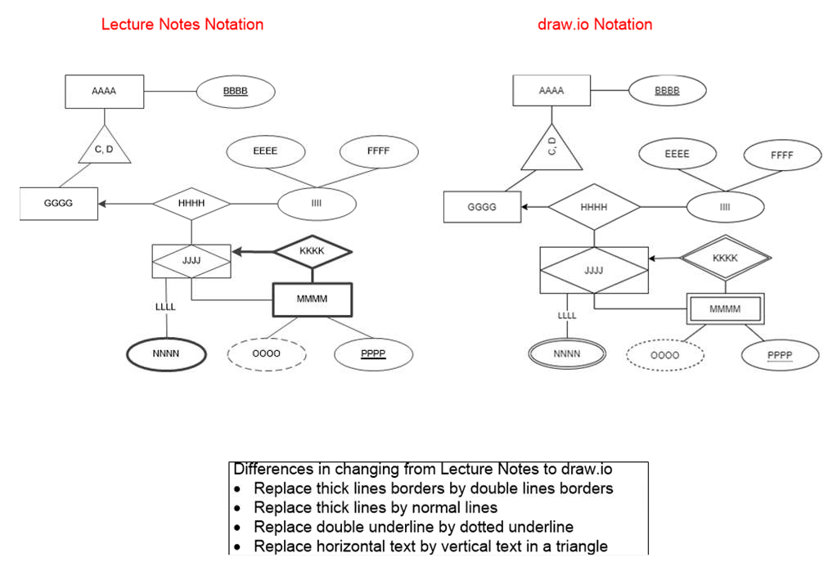
Notation: Lectures vs. draw.io

